Slide 1
HP rješenja za bežične mreže škola
Car Mitar-Veljko HP Hrvatska
SA za HPN
mitar@hp.com

Slide 2
HP Mobility rješenja
HP tipping
Point IPS 110
MSR50 router
Internet
Management console
(HP Intelligent Management Center)
HP 5400 zl switch & HP
MSM765zl access controller &
HP Threat Management Service
5400 zl module
Wireless clients
HP 29 10G-24 al
POE+ switch
HP MSM 460
wireless
access point
Client PC
HP RF manager controller
Wireless guest
HP MSM 466
wireless
access point
Client PC
Servers
Printers
HP MSM 415
RF security
sensor
Storage and backup
Notes:
This reference architecture supports up to 1000 users. This architecture is secure, flexible and highly available. In the next few slides, we’ll drill down into the detail.

Slide 3
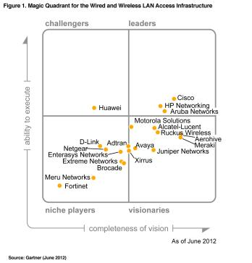
Gartner Magic Quadrant
Wired and Wireless LAN Infrastructure
Source: Gartner Magic Quadrant for Wired and Wireless LAN Infrastructure Magic Quadrant
June, 2012
ID Number: G00234282
This Magic Quadrant graphic was published by Gartner Inc. as part of a larger research note and should be evaluated in the context of the entire report. The Gartner report is available upon request from HP. Gartner does not endorse any vendor, product or service depicted in its research publications, and does not advise technology users to select only those vendors with the highest ratings. Gartner research publications consist of the opinions of Gartner's research organization and should not be construed as statements of fact. Gartner disclaims all warranties, expressed or implied, with respect to this research, including any warranties of merchantability or fitness for a particular purpose.
Notes:
I would like to start by sharing with some of HP Networking’s innovations that have transformed the industry.
This also gives you a context for where today’s news fits into a well-planned strategy which we are executing.
Click #1: Dating back to 2003, HP Networking drove many innovations that redefined campus economics by increasing the simplicity at the edge and removing operational costs with our lifetime warranty.
Click #2: HP delivered the industry’s first virtualized server edge connectivity with Virtual Connect in 2007
Click #3: In 2009, we introduced the Intelligent Resilient Framework, the industry’s first switch virtualization and fabric technology.
Click #4: In the very same year, we introduced the industry’s first single pane-of-glass management application with multivendor support, eliminating swivel-chair management. [twist at your hips from side to side when you say that ☺]
Click #5: Last year, we introduced the industry’s only unified architecture which spans from the data center where applications run to the users in the campus and branch where applications are consumed [extend your right and then you left arm to indicate the breadth of the unified architecture ☺]
Click #6: In February, we announced the industry’s first commercially available OpenFlow software – a key technology in Software Defined Networks – across 16 switch product lines.
Click #7: And just a few weeks ago, we announced the industry’s first cloud network technology that enables the deployment of cloud applications in minutes rather than months with Virtual Application Networks.

Slide 4

Zadatak
Modeli iz prezenetacije odabrani su tako da zadovoljavaju zahjeve iz Carnetovog dokumenta
e-Dnevnik SMJERNICE ZA BEŽIČNE MREŽE ŠKOLA

Slide 5
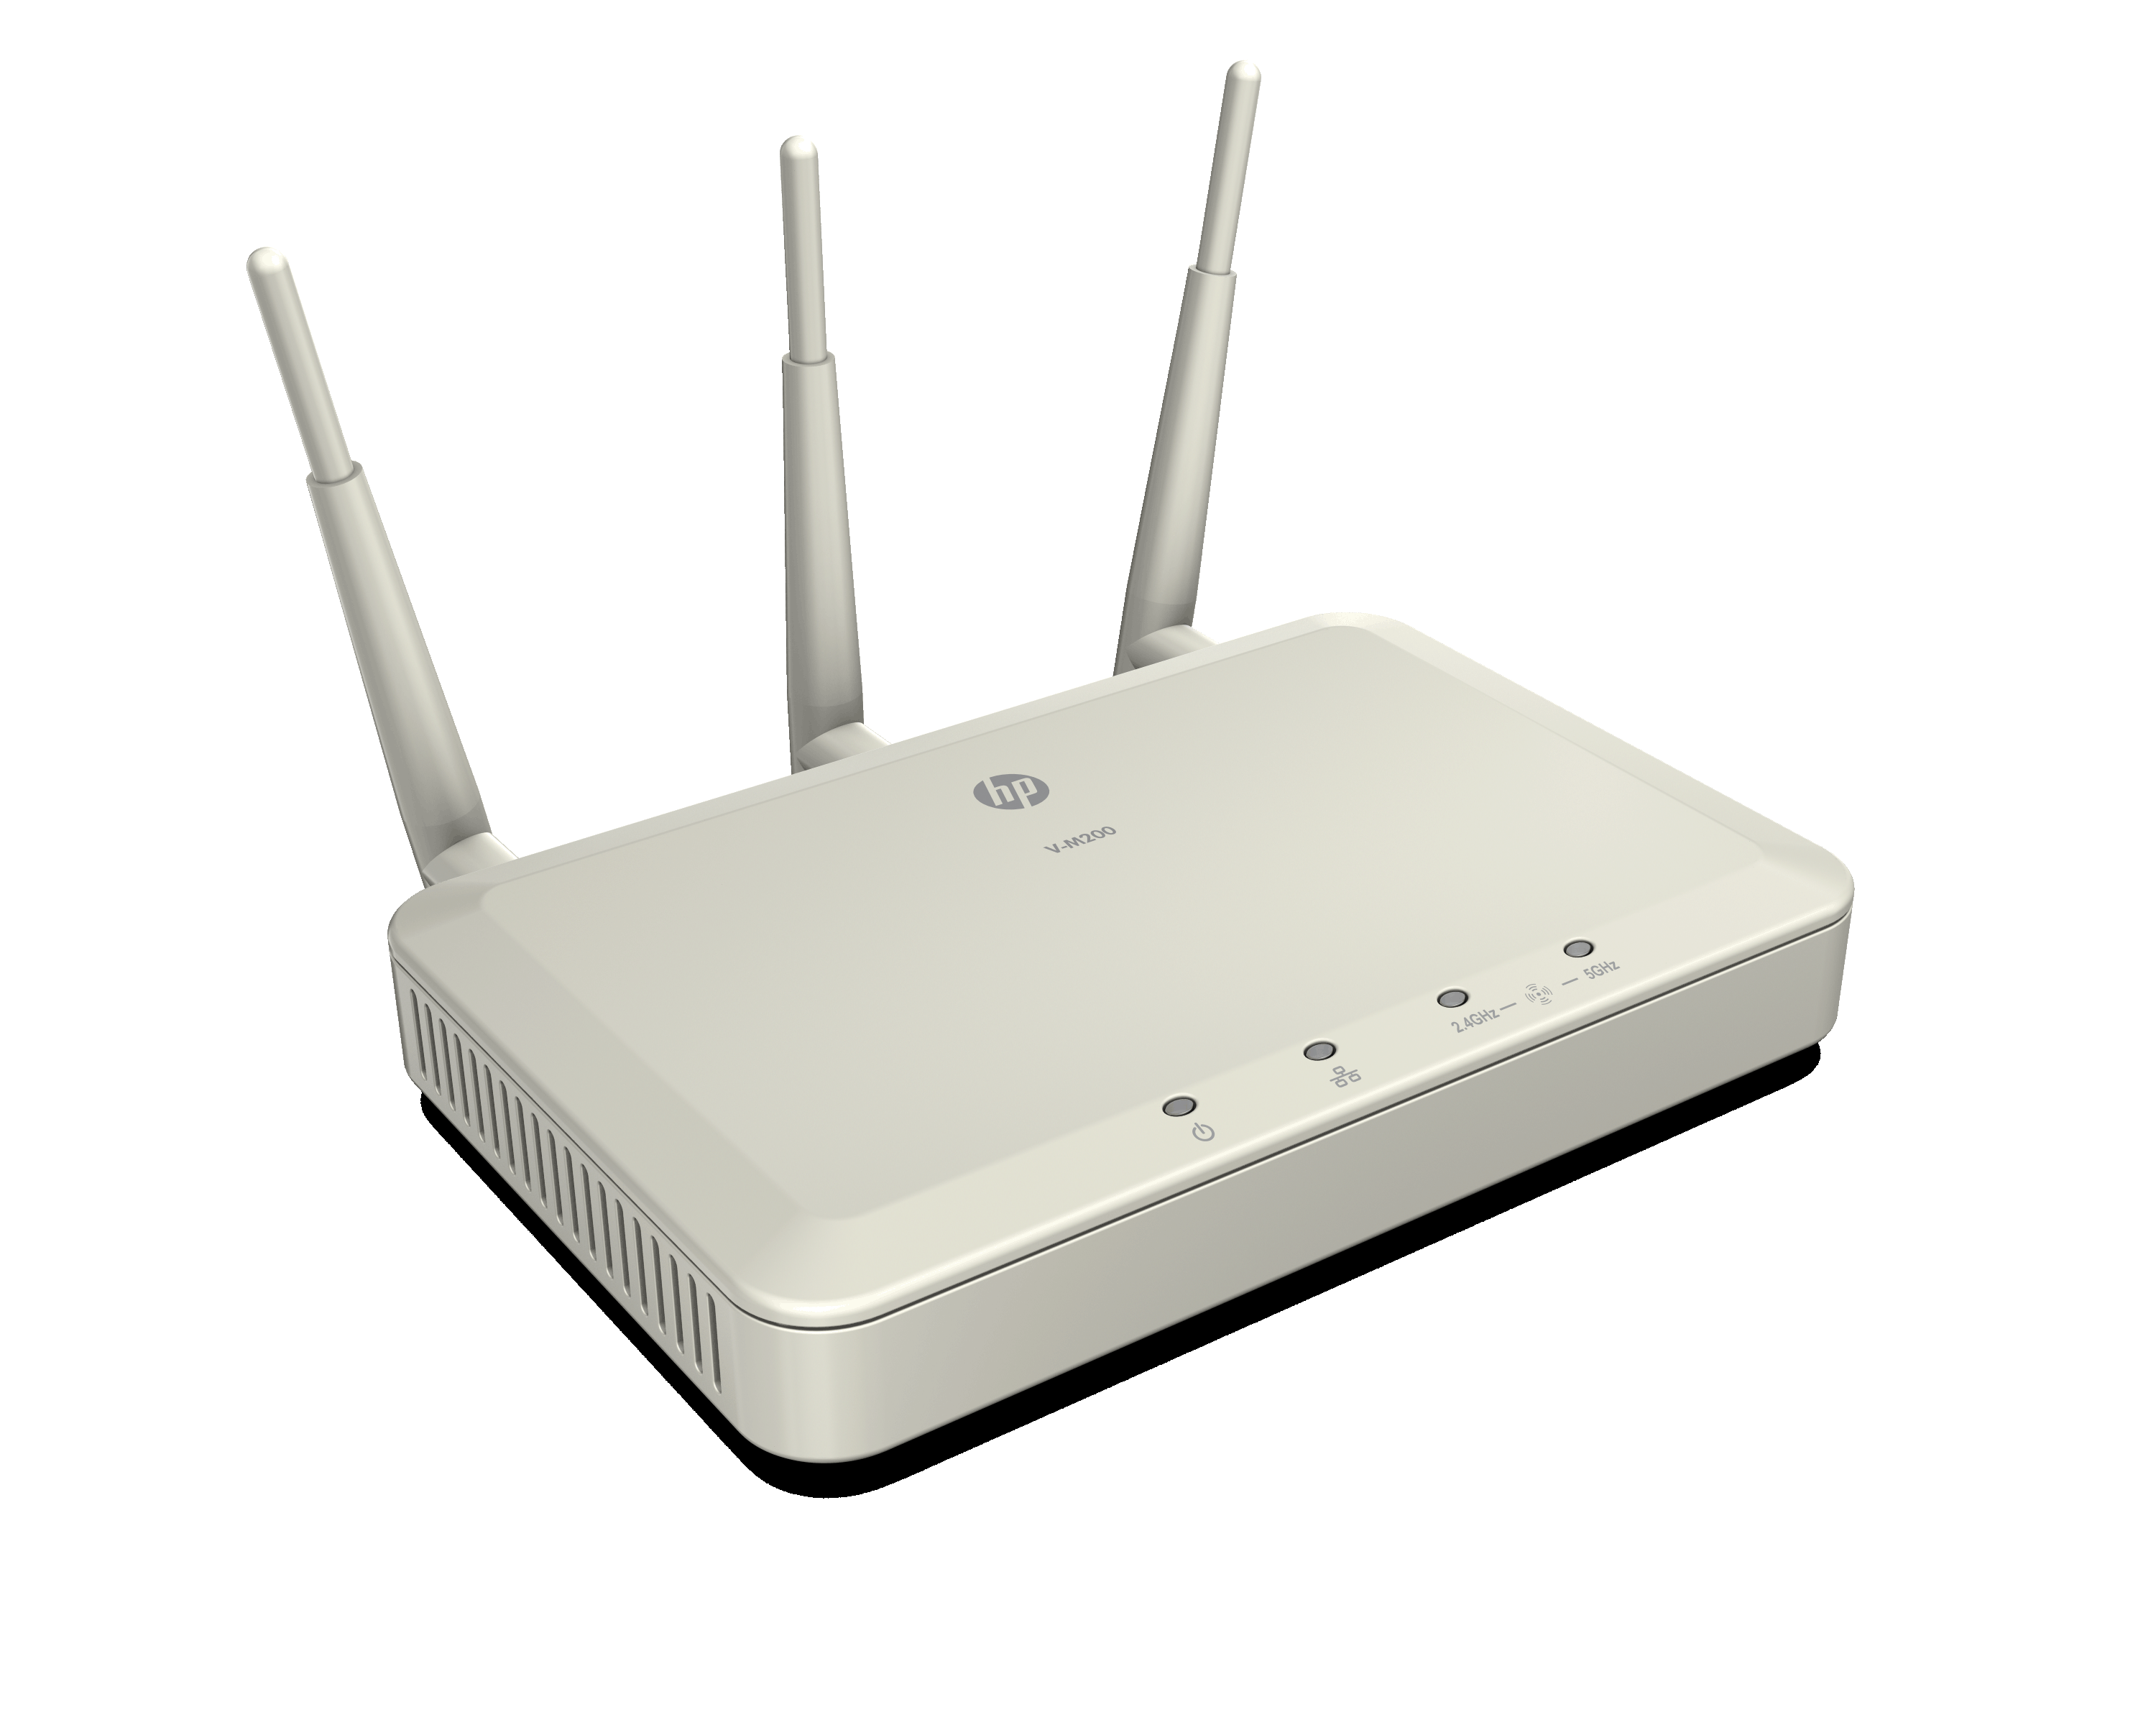

HP M200 802.11n Access Point
Potpuna kompatibilnost s 802.11n standardom
Samostalni uređaj, Intuitivno WEB upravljanje
Dual Band, podrška za 2.4GHz ili 5GHz klijente
4 SSIDs
Napajanje 802.3af PoE ili standardno
3 odvojiti 3x3 MIMO vanjske Omni-directional antene
Enterprise Level Security osobine
WPA/WPA2 (Personal/Enterprise) including IEEE 802.11i
MAC Filtering (MAC Access Control)
SSID Broadcast enable/disable
Client Isolation control per SSID
802.1X Client Authentication
RADIUS Authentication (Primary and Backup Server)
QOS osobine za optimizaciju mutimedijalnog prometa
WMM (802.11e)
802.1p
Mapping 802.1p priority to WMM priority
DiffServ prioritization

Slide 6
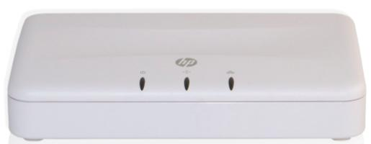
HP M220 bazna stanica
Bežična bazna stanica:
Osigurava bežično umrežavanje za prijenosna računala, računala, pametne telefone, tablete, i još mnogo toga, povezuje ih s postojećim LAN-om.
Podržva IEEE 802.11n standard:
Certificiran u skladu s popularnim high-speed Wi-Fi bežični standardom. Unatrag kompatibilan sa starijimWi-Fi standardima.
Dual Band način rada:
Podržava bežične veze na 2.4GHz ili 5GHz. Većina uređaja podržava 2.4GHz. Ako vaši uređaji podržavaju 5GHz, radi se pomoću .11 n je vjerojatno da će pružiti najviše performanse.
Pojednostavljena administracija za lokacije do 10 baznih stanica
Kada jedan AP ne može pokriti svoju malu tvrtku ili web lokaciju, HP M220 je pravi izbor.

Slide 7
Što je clustering?
Primarni primjer načina upotrebe
Clustering
Pruža jednu točku upravljanja i omogućuje implementaciju, pregled, konfiguriraciju i osigurava bežičnu mrežu kao jednu cjelinu, a ne kao niz odvojenih bežičnih uređaja
Grupe do 10 baznih stanicau istoj podmreži
Višestruki klasteri mogu postojati na istoj mreži
Konfiguriran s istim parametrima bežični Primjeri SSID (naziv bežične mreže) Bežični kodiranje - sigurnost Radio postavka VLAN
1 cluster s više baznih stanica (do 10)
Alternativni primjer načina upotrebe
Cluster A
Cluster B
Notes:
The AP cluster is a group of APs in the same wired subnet that share a common configuration. If the configuration of a member of the cluster is changed by the administrator, the cluster dynamically exchanges the new setting with all members of the cluster. This eliminates the need to separately access each access point to make the configuration change. One manages the cluster by accessing a member AP of the cluster via the Web user interface.
Multiple clusters can exist within a subnet. Each cluster can have up to 10 members.

Slide 8
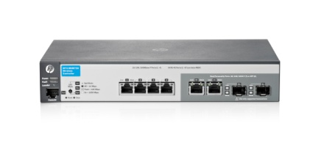
MSM720 Wireless Controller
Bazna licenca za 10 AP i nadogradivo do 40 AP Visoke performanse, skalabilan MSM kontroler nudi fleksibilne fizičke mogućnosti konfiguracije
4 RJ45 Gigabit porta (non-PoE) i dva dual personality porta
RJ-45 port konzole
IEEE 802.3ax linkova Agregacija Control Protocol (LACP) podrška Podržava dodatni paket Premium Mobility HP MSM720 Access Controller HP MSM720 Premium Mobility Controller Doživotno jamstvo na hardver Tehnička podrška i nadogradnja software-au životnom vijeku proizvoda

Slide 9
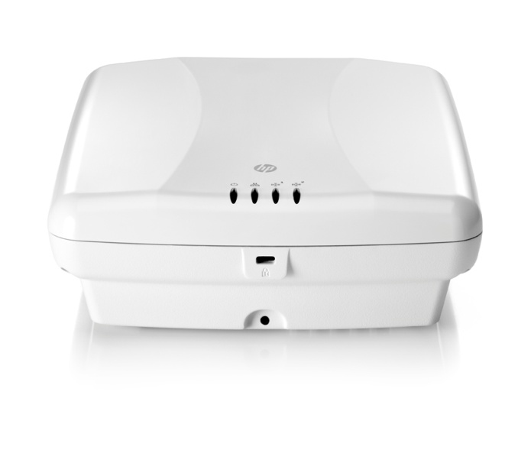
802.11n Bazna stanica MSM 430
Prvenstveno namijena ta rad s kontrolerom
Dual radio 802.11n APs
E-MSM430: 3x3:2, integrirane 4/7dBi antene
Propusnost do 300 Mbit/s
Napajane putem POE switcha ili power injector-a
Istovremen rad radio odašiljča u 5GHz band
Mogućsnot rada i kao samostalni uređaj

Slide 10

HP MSR900 Serija routera
MSR900W
(front)
Layer 2/Layer 3 Ethernet konekcije
2 FE WAN porta
4 10/100 Ethernet LAN porta
Performanse
Prosljeđivnje: 70Kpps
Enkripcija: 5Mbps
Firewall: 100Mbps
MSR900W
(back)
MSR900

Slide 11
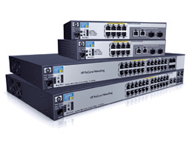
HP 2520 Linija preklopnika
Lakoća instalacije i korištenja
Potpuno upravljiv preklopnik s interaktivnim web korisničkim sučeljem kako bi se omogućilo jednostavan početni set up, konfiguraciju i praćenje
Verzije s 8 i 24 10/100 ili 10/100/1000 Mbit/s portovima
Jednostavan za implementaciju mrežnih uređaja s PoE opcijom i 10/100 ili 10/100/1000 sučeljem
Prilagodljive opcije implementacije: kompaktan trag, tihi rad za otvorenom prostoru, a više montažu opcije
Doživotna garancija
Source: miercom.com, cisco.com

Slide 12
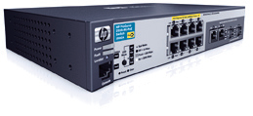
HP 2615/2915 linija preklopnika
Mogućnost skalabilnog 10/100 ili 10/100/1000 povezivanja
8 bakrenih +2 dual personality porta
Layer 2 i 3 mogućnosti rada
sFlow, ACL, rate limiting
Energetski učinkovit dizajn i tihi rad
Doživotna garancija

Slide 13
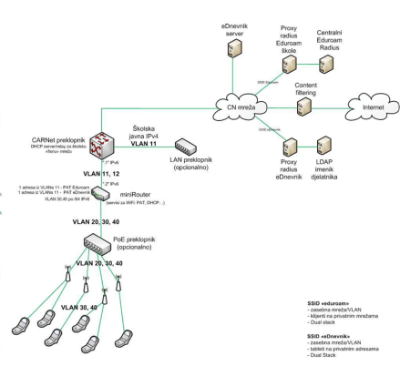
HP rješenje za škole s više od 3 AP-a
MSR router 900
DHCP
NAT
Preklopnik 2520/2615
Bazna stanica M200
ili
Bazna stanica M220

Slide 14
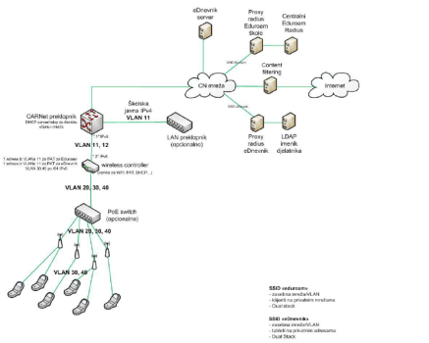
HP rješenje za škole s 3 ili više baznih stanica i korištenje hardverskog wireless kontrolera
Kontroler MSM 720/760
Preklopnik 2520/2615/2915
Bazna stanica MSM430

Slide 15
HP servisna mreža

Slide 16
Hvala

